Slide 1
Exploring Your Multiple Intelligences
Chapter 4

Slide 2
Your Mindset Makes a Difference
Growth Mindset:
Intelligence is increased as you learn new knowledge
Through practice and effort, skills can be improved
Failure is an opportunity to learn
Fixed Mindset:
Intelligence is fixed at birth
Hard work is unpleasant
The amount of work needed to be successful is underestimated
Roadblocks are an excuse to be absent

Slide 4
What is grit?
Grit is a combination of perseverance and passion.
It is a “never give up” attitude.

Slide 5
How do famous people achieve excellence?
NBA superstar
Pro football player
Gold medalist swimmer
Famous violinist

Slide 6
How to develop grit
Find interest.
Invest your time in practice.
Find your purpose.

Slide 8
Multiple Intelligences
Developed by Howard Gardner
Defined as the human ability to solve problems or design or compose things valued in at least one culture
Broadens the scope of human potential

Slide 9
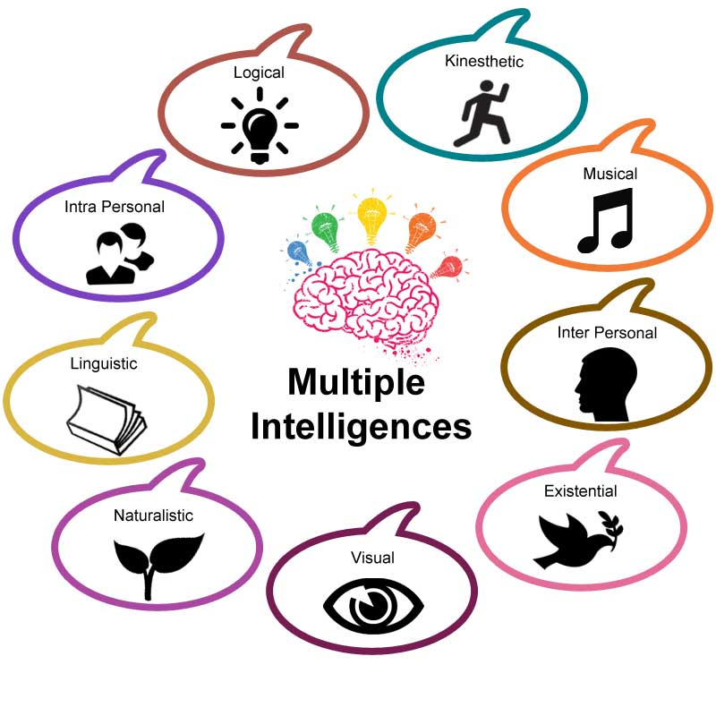

Slide 10
Three Factors
Heredity
Personal Life History
Cultural and historical background
Key Idea: You can develop your multiple intelligences.

Slide 11
Life History
Crystallizers promote the development of the intelligence.
Paralyzers inhibit the development of the intelligence.
What are some factors that affected your intelligences early in life?

Slide 12
Your textbook provides an opportunity to explore your multiple intelligences. Use the access code to take the AchieveWORKS Intelligences assessment.

Slide 13
Choose Your Career with Multiple Intelligence in Mind

Slide 14
Build on Your Strengths
Musical
Listening to music
Singing or playing an instrument
Recognizing musical patterns
Musical Smart
Careers
Disc Jockey
Music Teacher
Music Retailer
Music Therapist
Singer
Song Writer
Music Critic
Music Lawyer

Slide 15
Build on Your Strengths
Interpersonal
Communication
Social skills
Helping others
Resolve conflicts
People Smart
Careers
Cruise Director
Mediator
Human Resources
Dental Hygienist
Nurse
Psychologist
Social Worker
Marketer
Counselor

Slide 16
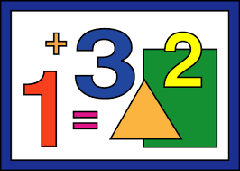
Build on Your Strengths
Logical-Mathematical
Math aptitude
Interest in science
Problem solving
Logical thinking
Number Smart
Careers
Engineer
Accountant
Computer Analyst
Physician
Detective
Researcher
Scientist
Economist

Slide 17
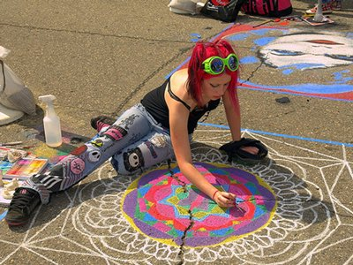
Build on Your Strengths
Spatial
Visualization
Navigation
Reading
Writing
Picture Smart
Careers
Architect
Artist
Film animator
Mechanic
Pilot
Webmaster
Interior decorator
Graphic artist
Photographer

Slide 18
Build on Your Strengths
Bodily- Kinesthetic
Hand and eye
coordination
Athletics
Dance
Drama
Cooking
Learning by doing
Body Smart
Careers
Athlete
Carpenter
Craftsperson
Mechanic
Jeweler
Computer game designer
Firefighter
Forest ranger
Physical therapist

Slide 19
Build on Your Strengths
Linguistic
Reading
Writing
Vocabulary
Spelling
Good listener
Good memory
Word Smart
Careers
Journalist
Writer
Editor
Attorney
Curator
Newscaster
Politician
Librarian
Comedian

Slide 20
Build on Your Strengths
Careers
Career counselor
Wellness counselor Therapist
Criminologist
Intelligence officer
Entrepreneur
Researcher
Actor
Artist
Intrapersonal
Self-aware
Understand emotions
Independent
Self-motivated
Self Smart

Slide 21
Build on Your Strengths
Naturalist
Aware of natural surroundings
Preserve the environment
Nature Smart
Careers
Park ranger
Dog trainer
Landscaper
Meteorologist
Veterinarian
Animal health technician
Ecologist
Wilderness guide
Environmental lawyer

Slide 22
Build on Your Strengths
Existential
Questioning
Purpose of life
Religious beliefs
Curiosity Smart
Careers
Counselor
Psychologist
Psychiatrist
Social worker
Ministry
Philosopher
Artist
Scientist
Researcher

Slide 23
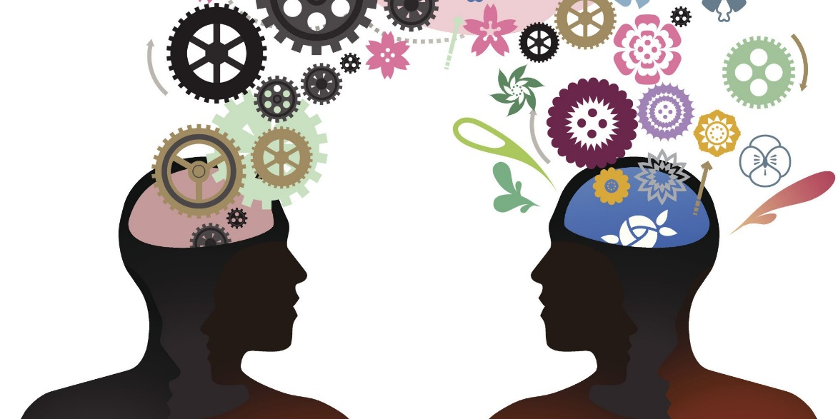
Emotional Intelligence
Interpersonal + Intrapersonal
The ability to recognize, control, and evaluate your emotions while realizing how they affect other people

Slide 24
Emotional Intelligence
Two Parts:
Understanding yourself, your goals, intentions, responses and behavior
Understanding others and their feelings

Slide 25
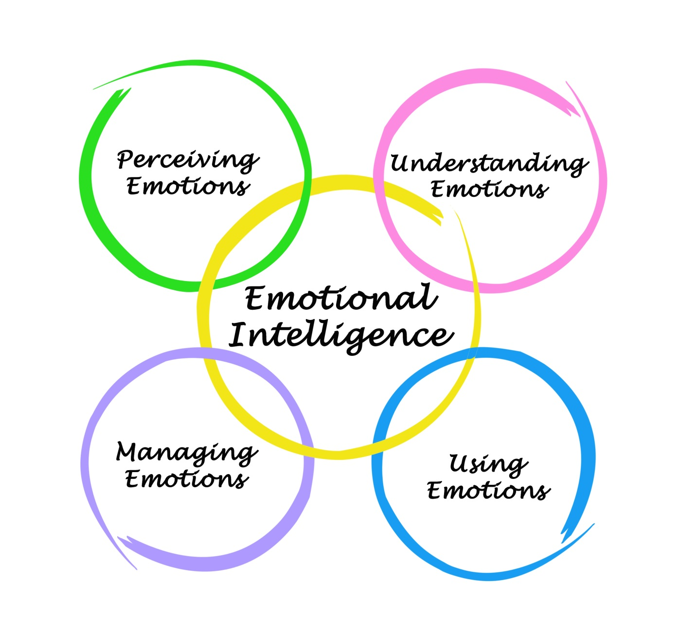
Emotional Intelligence

Slide 26
Emotional Intelligence
Express yourself
Work as part of a team
Concentrate
Remember
Make decisions
Deal with stress
Overcome challenges
Deal with conflict
Empathize with others

Slide 27
How Can You Develop Emotional Intelligence?

Slide 28
Developing Emotional Intelligence
Use empathy.
Think about how your actions affect others.
Be intellectually curious.
Give others credit for their accomplishments.
Work on stress management.
Take a college course on verbal and nonverbal communication.
Take responsibility for your actions.

Slide 29
These intelligences work together in complex ways to make us unique individuals.

Slide 30
Multiple Intelligences Matching Quiz
Michael Jordan
Aristotle
Martin Luther King Jr
Sigmund Freud
William Shakespeare
Albert Einstein
“Will. i am”
Charles Darwin
George Lucas
Musical hearing and remembering musical patterns
Interpersonal: understanding other people
Mathematical: working with numbers
Spatial: manipulating objects in space
Bodily-Kinesthetic: using your body
Linguistic: using language
Intrapersonal: understanding yourself
Naturalist: understanding the environment
Existential: pondering the meaning of life and our place in the universe.

Slide 31
Keys to Success: Persistence and Grit

Slide 32
Persistence Will Get You Almost Anything Eventually
When is this true?
When is it not true?

Slide 33
90% of success is showing up! (You also have to do some work when you get there.)

Slide 34
Make a commitment to reach your dreams.

Slide 35
Getting a college degree can be like climbing Mt. Everest.

Slide 36
How to Climb Mt. Everest
A small step at a time

